Slide 1
LEARNING OUTCOME 1
Business and the Business Environment

Slide 2

LEARNING OUTCOME1
Explain the different types, size and scope of organisations

Slide 3
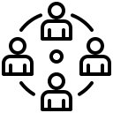

KEY LEARNING
Different types of organisations
Size and scope of organisations

Slide 4
Write different types of Organisations
There are several types of organizations that exist, each with its own purpose, structure, and characteristics. Here are some common types of organizations:
Sole proprietorship: A sole proprietorship is a business owned and operated by a single individual. It is the simplest form of business organization and has no separate legal entity from its owner.
Partnership: A partnership is a business owned by two or more people who share in the profits and losses of the business. Partnerships can be general partnerships or limited partnerships.
Corporation: A corporation is a legal entity that is separate from its owners. It has its own legal rights and obligations and can enter into contracts, sue and be sued, and pay taxes.
Limited Liability Company (LLC): An LLC is a hybrid business structure that combines the limited liability protection of a corporation with the tax benefits of a partnership.
Non-profit organization: A non-profit organization is an organization that is formed for a charitable, educational, religious, or other purpose, rather than for profit. Non-profit organizations can include charities, foundations, and social welfare organizations.

Slide 5
Differences between for profit and not for Profit:
For-profit organizations and not-for-profit organizations differ in their primary purpose, governance, and funding. Here are some key differences
01
Purpose:
The primary purpose of a for-profit organization is to make a profit for its owners or shareholders, while a not-for-profit organization's primary purpose is to serve a specific mission or cause, such as providing charitable or educational services.
02
Governance
For-profit organizations are typically governed by a board of directors or shareholders, who are responsible for making decisions about the company's operations and financial direction. Not-for-profit organizations are governed by a board of directors or trustees, who are responsible for overseeing the organization's mission and ensuring it is fulfilling its charitable purpose.
03
Funding
For-profit organizations raise money through sales of goods and services, investments, and other revenue-generating activities. Not-for-profit organizations rely on donations, grants, and other forms of fundraising to support their mission and activities.

Slide 6
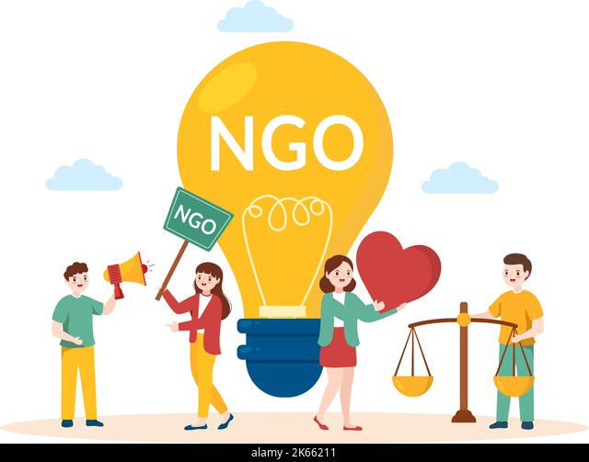
Non-government organisations (NGOs)
Non-government organizations (NGOs) are a type of not-for-profit organization that operates independently of any government. Unlike government agencies, NGOs are not part of the government and are not funded by the government. NGOs are typically formed to address a specific social, environmental, or humanitarian issue, and they may work at the local, national, or international level

Slide 7
Here are some key differences between NGOs and government agencies:
Independence: NGOs operate independently of the government and are not subject to government control or regulation. Government agencies, on the other hand, are part of the government and are subject to government oversight and regulation.
Funding: NGOs rely on donations, grants, and other forms of fundraising to support their work, while government agencies are funded by taxpayer dollars.
Mission: NGOs are typically formed to address a specific issue or cause, such as poverty, human rights, or environmental conservation. Government agencies may have a broader mandate and may be responsible for a range of services and programs, such as national defense, healthcare, and education
Flexibility: NGOs are often more flexible and adaptable than government agencies, as they are not bound by bureaucratic rules and regulations. They can respond quickly to changing circumstances and can be more innovative in their approach to problem-solving.

Slide 8
Micro-, small-, medium-sized enterprises (SMEs)
Micro-, small-, medium-sized enterprises (SMEs) are businesses that are characterized by their small size and limited resources. These businesses are typically defined by the number of employees and their annual turnover or total assets. The exact definition of what constitutes an SME varies by country, but there are general guidelines used by many international organizations.
In the European Union (EU), for example, a micro-enterprise is defined as having fewer than 10 employees and a turnover or balance sheet total of less than €2 million. A small enterprise has fewer than 50 employees and a turnover or balance sheet total of less than €10 million, while a medium-sized enterprise has fewer than 250 employees and a turnover of less than €50 million or a balance sheet total of less than €43 million.
SMEs are a vital part of many economies, providing employment opportunities and driving innovation and economic growth. They are often more flexible and adaptable than larger companies, allowing them to respond quickly to changing market conditions. However, SMEs can face significant challenges, such as limited access to financing and regulatory burdens, that can make it difficult for them to grow and compete with larger firms.

Slide 9
Different business purposes, objectives and supply of goods and services.
Businesses can have different purposes and objectives depending on the industry they operate in, their size, and the needs of their stakeholders. However, at a high level, the main purpose of a business is to provide goods and services to customers in order to generate revenue and profits.
The supply of goods and services is an important aspect of business operations. Businesses must ensure that they have a reliable supply of the raw materials, equipment, and labour needed to produce their goods or services. They may source these inputs from suppliers or produce them in-house.

Slide 10
The following are some common business objectives:
Social responsibility: Some businesses may prioritize social responsibility by engaging in activities that benefit the community and the environment.
Profit maximization: The primary objective of most businesses is to maximize profits. This can be achieved by increasing sales, reducing costs, or a combination of both
Customer satisfaction: Businesses may aim to provide high-quality goods and services to their customers in order to maintain their loyalty and attract new customers
Growth: Businesses may seek to grow by expanding their operations, entering new markets, or acquiring other businesses.

Slide 11
The range of legal structures associated with different forms of business:
The legal structure of a business defines how it is organized, owned, and operated. There are several legal structures associated with different forms of business, including sole traders, partnerships, and limited companies

Slide 12


Sole trader and Partnership
Sole trader
Partnership
A sole trader is a self-employed individual who runs their own business. They are responsible for all aspects of the business, including financing, operations, and marketing. Sole traders are personally liable for the debts and obligations of their business, and they must register for self-employment with tax authorities.
A partnership is a business structure in which two or more individuals share ownership and responsibility for the business. Partnerships can be general or limited, with general partners having unlimited liability for the debts and obligations of the business, and limited partners having limited liability.

Slide 13
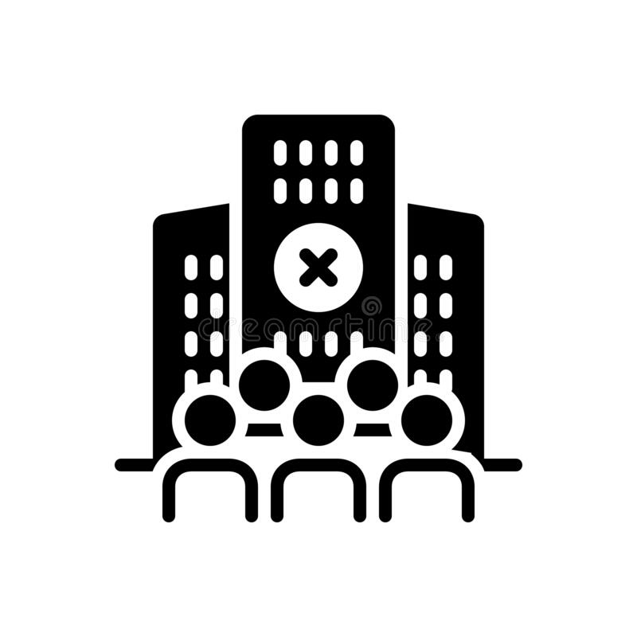
Limited company
A limited company is a separate legal entity from its owners, with limited liability for its debts and obligations. It can be a private limited company (Ltd) or a public limited company (PLC). The owners of a limited company are called shareholders, and the company is run by directors appointed by the shareholders. Limited companies are subject to various regulations and requirements, including the filing of annual accounts and compliance with company law.

Slide 14

Size and scope of organisations
The size and scope of organizations can vary greatly depending on the industry, the type of organization, and its goals. Generally, the size of an organization can be measured by the number of employees, the annual revenue, or the physical footprint of its operations.
1.Small organizations typically have fewer than 50 employees and generate less than a few million dollars in annual revenue.
2.Medium-sized organizations may have up to several hundred employees and generate tens of millions of dollars in annual revenue.
3. Large organizations can have thousands of employees and generate billions of dollars in annual revenue.
The scope of an organization refers to the range of its activities and operations. Some organizations are specialized in a particular industry or market, while others have diverse business interests across multiple industries. The scope of an organization can also be measured by its geographic presence, whether it operates locally, nationally, or internationally

Slide 15
Global growth and developments of transnational, international and global organisations
Transnational, international, and global organizations have experienced significant growth and development in recent years due to globalization and advancements in technology. These organizations operate in multiple countries, and their operations often span multiple industries and markets.
1.Transnational organizations are typically large corporations that operate in multiple countries and have a centralized management structure. These organizations have a global presence but often tailor their products and services to meet the needs of specific regional markets. They also tend to have a high degree of control over their subsidiaries and operations in different countries.

Slide 16
2.International organizations, on the other hand, typically have a decentralized management structure and allow their subsidiaries in different countries to operate with a high degree of autonomy. These organizations often focus on exporting goods and services to different countries and may also engage in joint ventures and partnerships with local businesses
3.Global organizations, meanwhile, are often characterized by their focus on sustainability, social responsibility, and environmental impact. These organizations seek to balance their business interests with the needs of society and the environment, and often operate in a transparent and ethical manner

Slide 17
Franchising, joint ventures, and licensing are all different ways that businesses can expand their operations beyond their home market
Differences between franchising, joint ventures and licensing
1.Franchising:
Franchising is a business model where a company (the franchisor) allows another party (the franchisee) to use its brand, products, and services in exchange for a fee. The franchisee is usually required to follow specific guidelines and standards set by the franchisor.
2.Joint Ventures:
A joint venture is a business agreement between two or more parties to undertake a specific business project or enterprise. Each party contributes capital, resources, and expertise to the venture and shares in the profits and losses.
3.Licensing:
Licensing is an agreement in which a company (the licensor) allows another party (the licensee) to use its intellectual property (such as trademarks, patents, and copyrights) in exchange for a fee or royalty

Slide 18

Industrial structures
Industrial structures refer to the characteristics of a market that affect how companies compete within that market. There are several types of industrial structures, including:
Perfect competition: Perfect competition is an ideal market structure in which there are many buyers and sellers, and no single company has significant market power. Companies in a perfectly competitive market must accept the prevailing market price, and there is little room for differentiation or pricing power.
Monopoly: A monopoly is a market structure in which a single company controls the entire market. In a monopoly, the company has significant pricing power and may be able to charge higher prices than in a competitive market. Monopolies may arise due to barriers to entry, such as patents or regulations, or due to natural monopolies, such as utility companies.
Oligopoly: An oligopoly is a market structure in which a few large companies dominate the market. In an oligopoly, the dominant companies may have significant pricing power and may engage in non-price competition, such as advertising or product differentiation. Oligopolies may arise due to economies of scale or barriers to entry.

Slide 19
Competitive analysis
Competitive analysis is the process of gathering and analyzing information about a company's competitors in order to understand their strengths, weaknesses, strategies, and market position. Competitive analysis can help a company identify potential opportunities and threats, improve its own strategies, and ultimately gain a competitive advantage in the market.
Here are some key steps in the competitive analysis process:
Identify competitors: The first step in competitive analysis is to identify the main competitors in the market. This may involve researching similar companies, products or services, or conducting market research to understand the competitive landscape.
Gather information: Once the competitors have been identified, the next step is to gather information about their strategies, strengths, weaknesses, and market position. This may involve analyzing financial reports, marketing materials, product reviews, customer feedback, and other sources of information.
Analyze information: After gathering information, it's important to analyze it to identify patterns, trends, and key insights. This may involve comparing the competitors' products, pricing, marketing strategies, and other factors to identify areas where the company can differentiate itself and gain a competitive advantage.

Slide 20
Market forces and economic operations
Market forces and economic operations are fundamental concepts in economics that shape the way markets function and influence decisions made by individuals and businesses.

Slide 21
Here are market forces and economic operations:
1.Scarcity: Scarcity is the fundamental economic problem of having seemingly unlimited human wants and needs in a world of limited resources. It forces individuals, businesses, and governments to make choices about how to allocate resources.
2.Choice: Choice refers to the decisions made by individuals, businesses, and governments to allocate resources in the face of scarcity. Choices are made based on personal preferences, costs, and benefits.
3.Supply and demand: Supply and demand are the two primary forces that drive market prices. The law of supply states that as the price of a good or service increases, the quantity supplied will also increase. The law of demand states that as the price of a good or service increases, the quantity demanded will decrease.
3.Market equilibrium: Market equilibrium occurs when the quantity demanded of a good or service equals the quantity supplied, resulting in a stable market price.
4.Elasticity: Elasticity refers to the responsiveness of consumers and producers to changes in price or income. Income elasticity measures the degree to which the quantity demanded of a good or service changes in response to changes in income.

Slide 22
Stakeholders and responsibilities of organisations to meet different stakeholder interests and expectation
Stakeholders are individuals or groups who have an interest or concern in the activities of an organization, either because they are affected by the organization's actions or because they can influence the organization's decisions. Stakeholders can include customers, employees, shareholders, suppliers, government, communities, and the environment.

Slide 23
Here are some key stakeholders and the responsibilities of organizations to meet their interests and expectations:
Customers
Employees
Shareholders
Customers are the most important stakeholders for any organization, as they provide the revenue that sustains the business.
Organizations have a responsibility to provide a safe and healthy work environment, fair compensation, opportunities for career development, and a good work-life balance.
Shareholders invest in the organization and expect a return on their investment. Organizations have a responsibility to maximize shareholder value by generating profits and increasing the stock price,

Slide 24
Thank You

